Slide 1


Cabbages and their cousins:
The dogs of the plant world
REACT Activity
July 14, 2022
Merritt Khaipho-Burch and Aimee Schulz

Slide 2

Introductions
Phoenix, Arizona and Hilo, Hawaii
5th year PhD student in Plant Breeding and Genetics
B.S. Cell and Molecular Biology
M.Sc Biology (Maize Genetics)
Merritt Khaipho-Burch
she/hers/hers

Slide 3
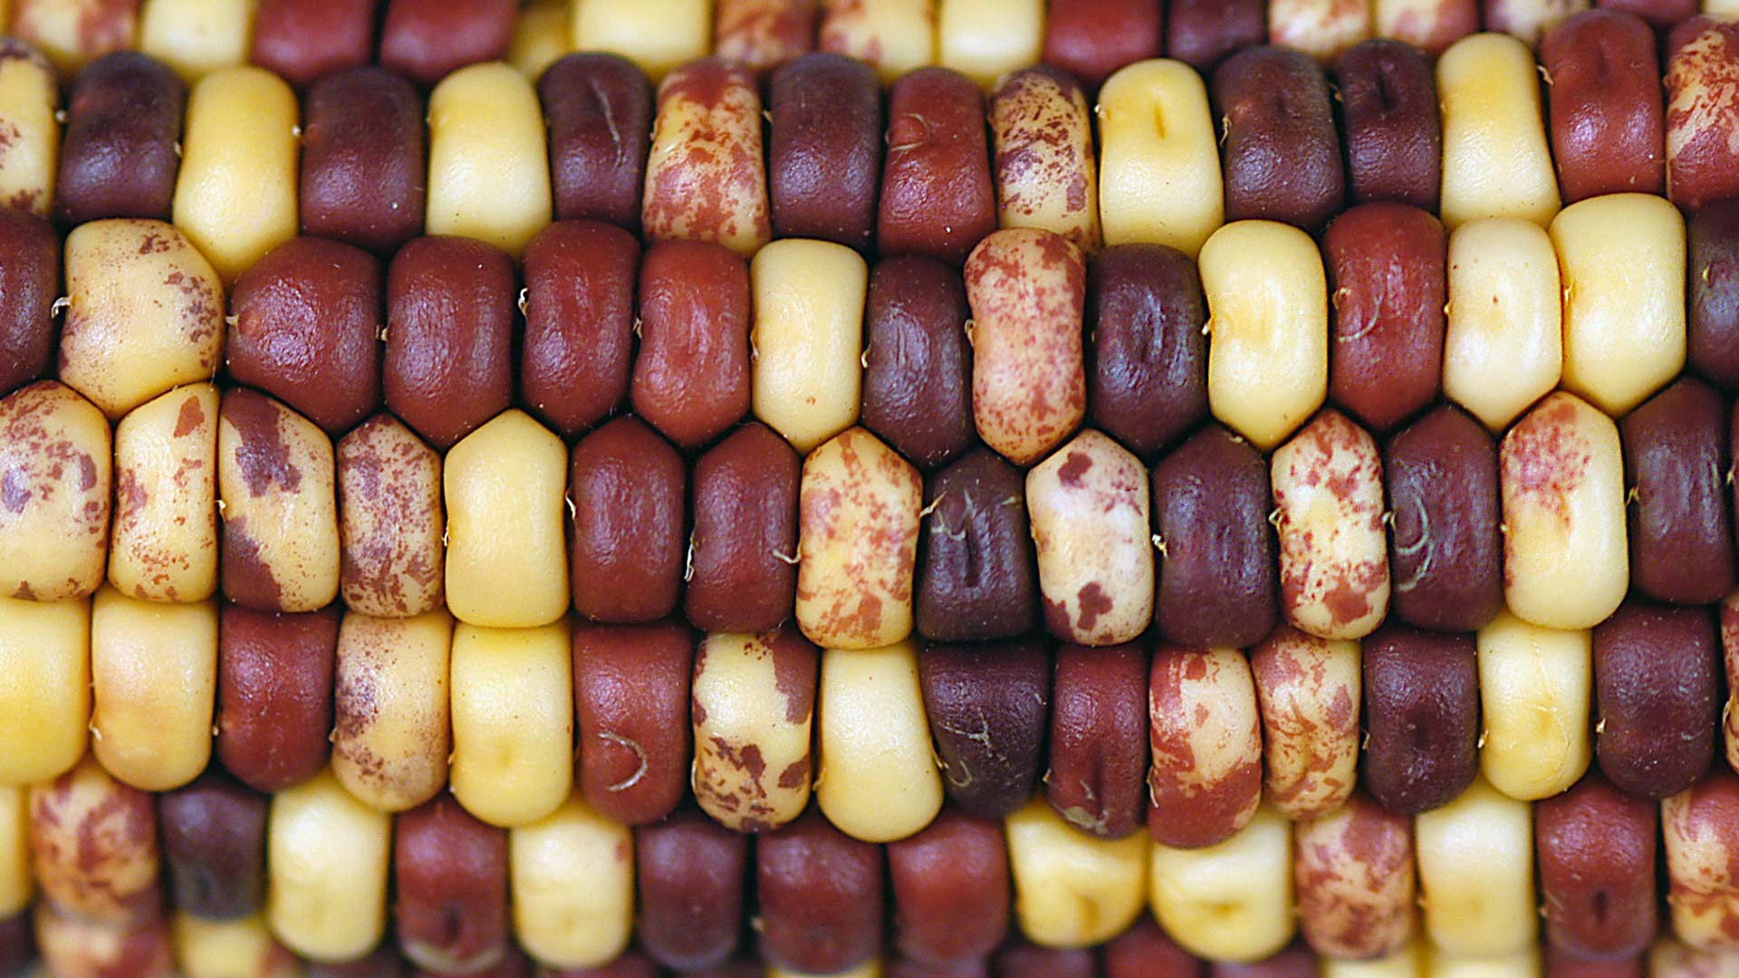
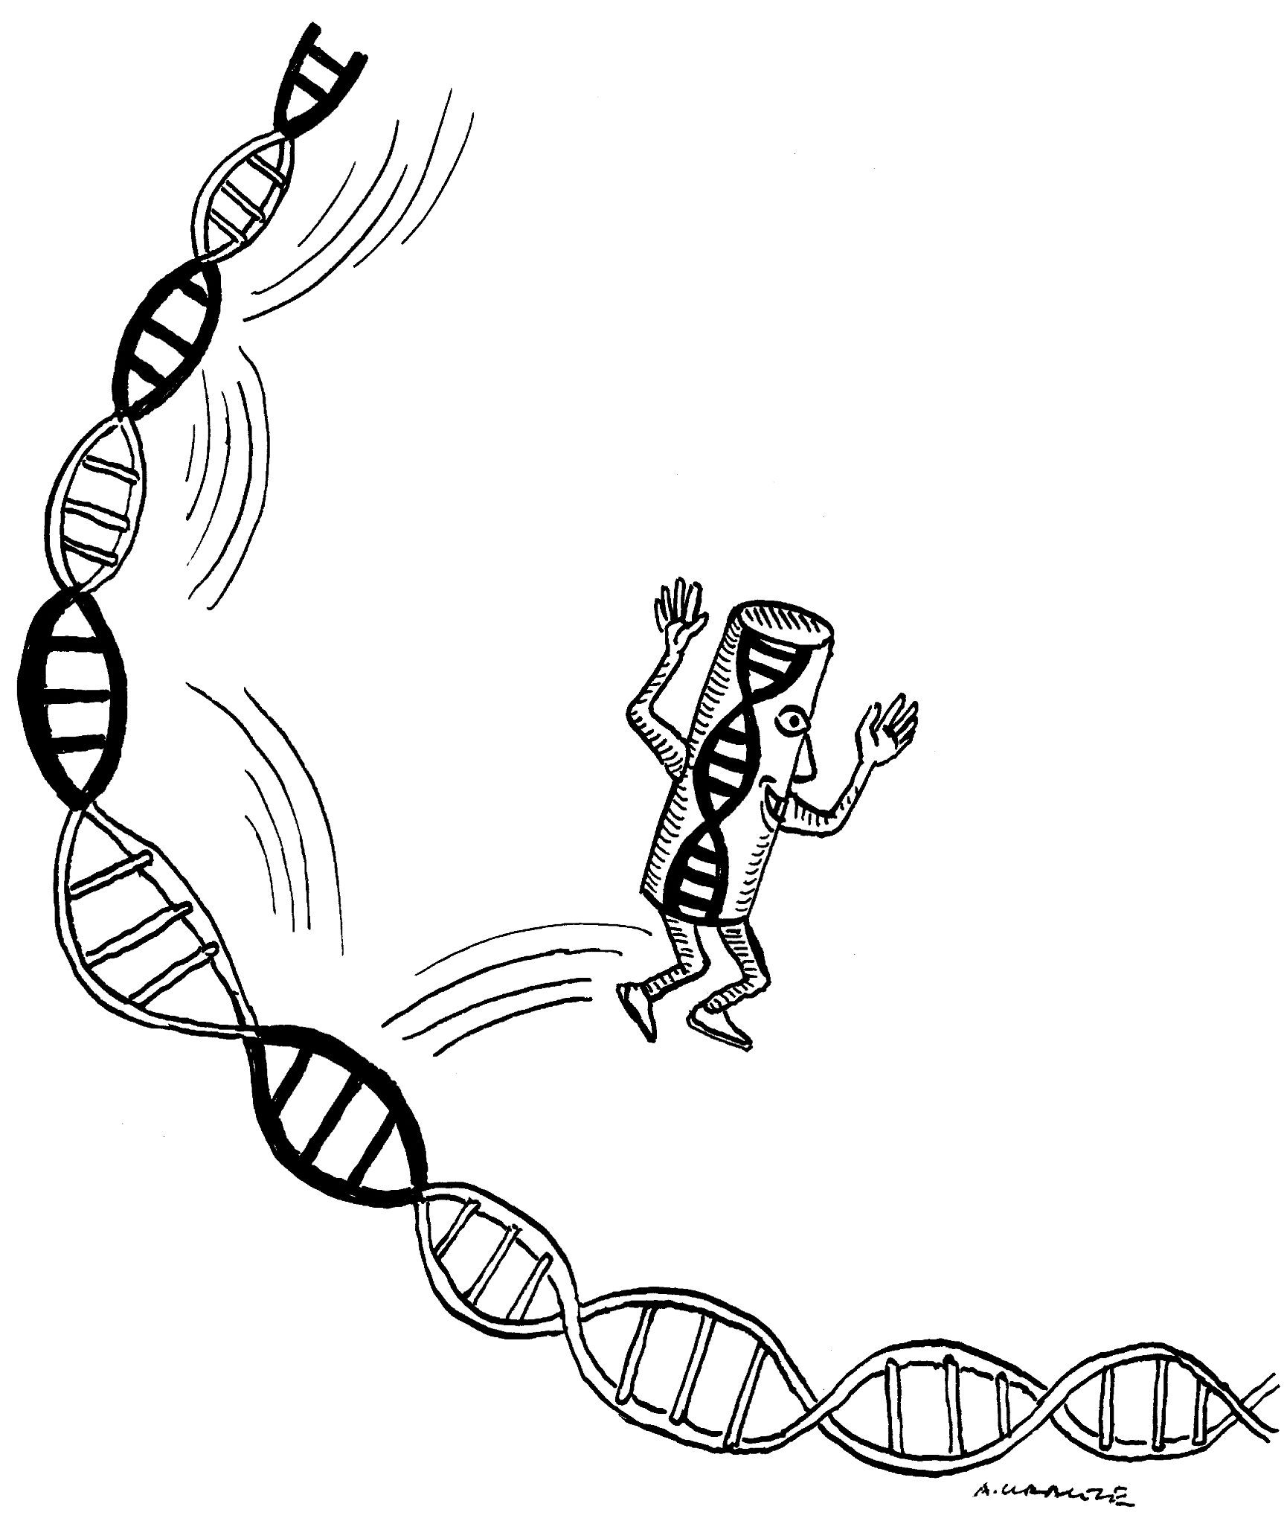
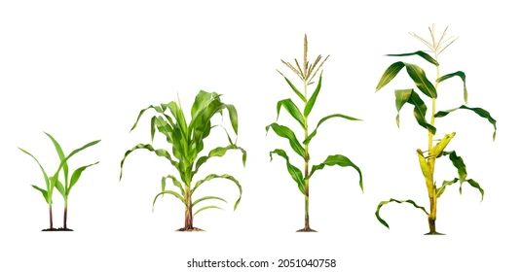
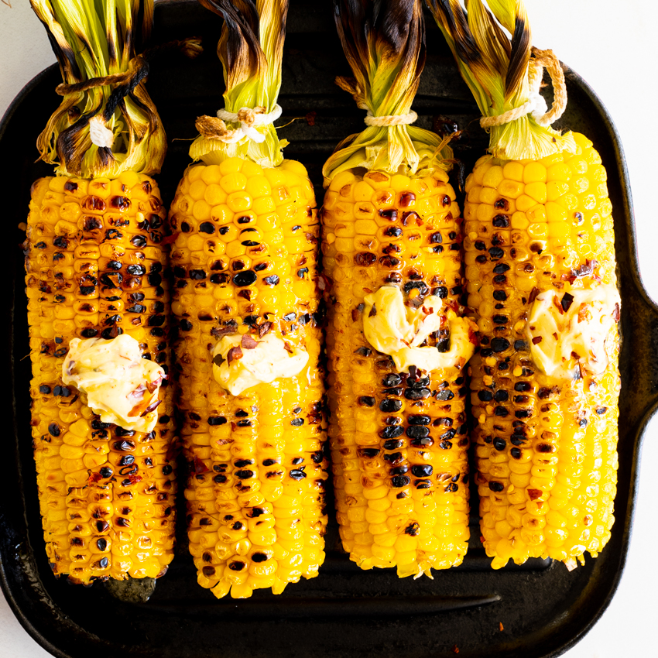
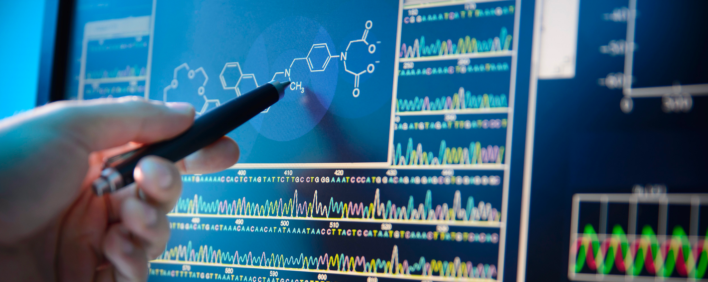
My research

Slide 4
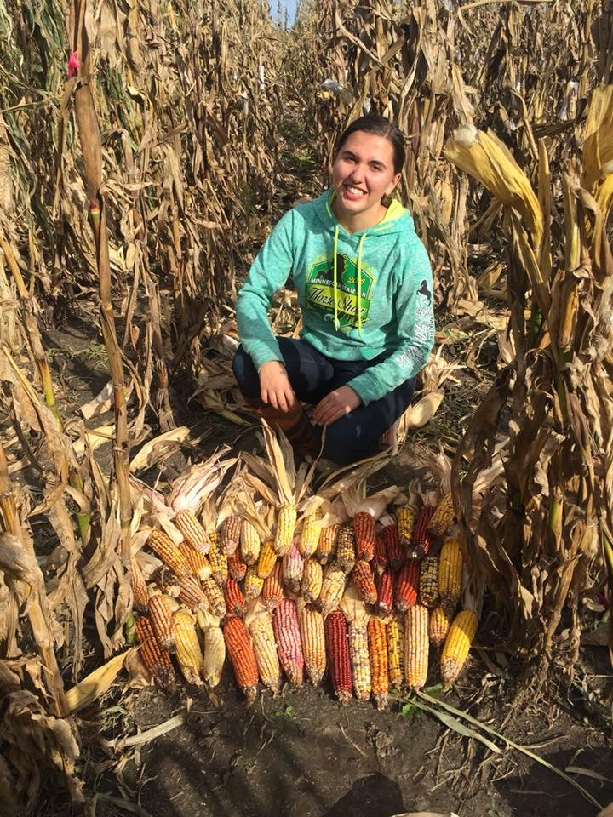
Introductions
Becker, Minnesota
4th year PhD student in Plant Breeding and Genetics
B.S. Genetics B.S. Agronomy (Plant Breeding & Biotechnology)
Aimee Schulz
she/hers/hers

Slide 5
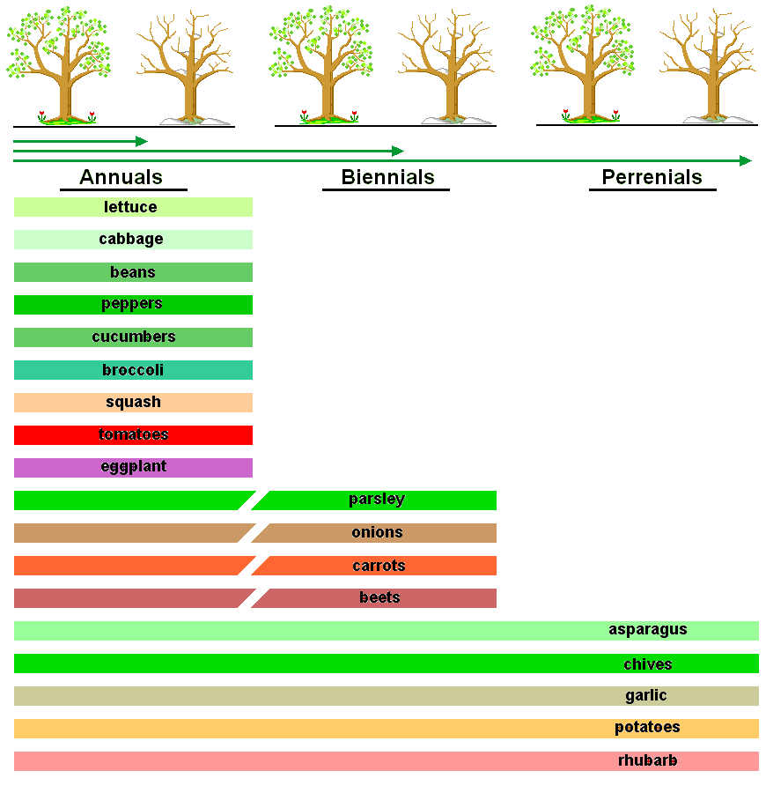

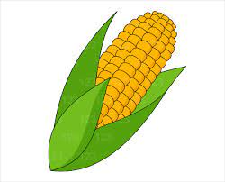
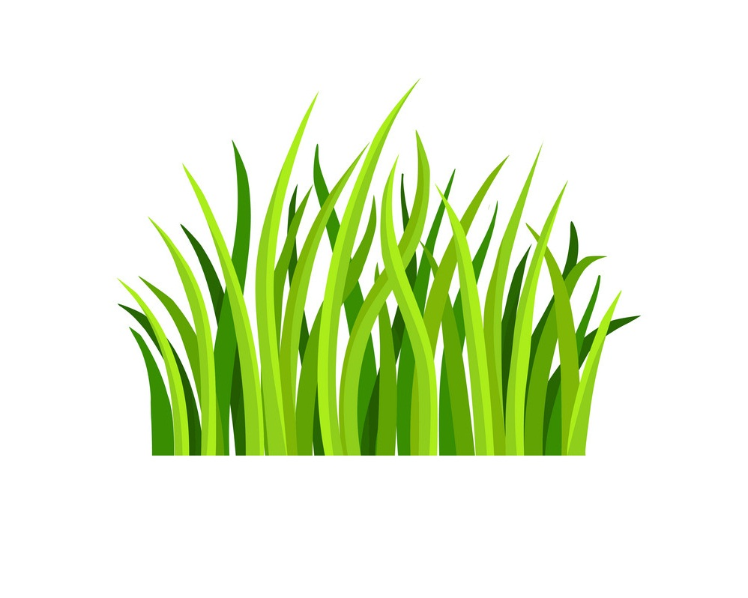
My research
Can we make corn more like a perennial?

Slide 6
What do plant breeders do?
Plant breeding: The art, science, and business of improving plants for human benefit.
Use scientific methods to:
Decide which plant parents to cross
Which selection methods to use
Which crosses to keep
Which varieties to release
So many ways to be involved:
Business or project managers
Computational biologists
Lab biologists
Geneticists
Field technicians/managers
App/IT development
Teaching and outreach
Potential employers:
Universities
Seed companies
Corteva/Pioneer
Bayer/Monsanto
Government
USDA
Department of Defense
International agriculture

Slide 7
Agenda
Science learning standards
Activity overview
Scientific background
Methods
Dissection & Investigation
Results & Discussion
Assemble super cabbages

Slide 8
Science Learning Standards
Middle school: MS-LS4-1 and MS-LS4-2 Biological Evolution: Unity and Diversity
“using evidence to explain the influence each of the four factors has on number of organisms, behaviors, morphology, or physiology in terms of ability to compete for limited resources and subsequent survival of individuals and adaptation of species.”
High school: HS-LS4-2 and HS-LS4-4 Biological Evolution: Unity and Diversity
“Communicate scientific information that common ancestry and biological evolution are supported by multiple lines of empirical evidence.”
“Construct an explanation based on evidence for how natural selection leads to adaptation of populations.”

Slide 9
Scientific Background

Slide 10
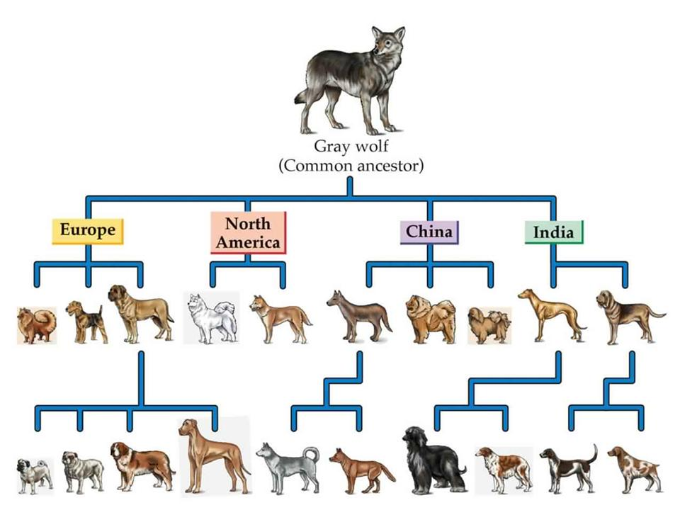
Dog Domestication
Canis lupus familiaris
First species domesticated by humans 15-25k years ago in Siberia

Slide 11
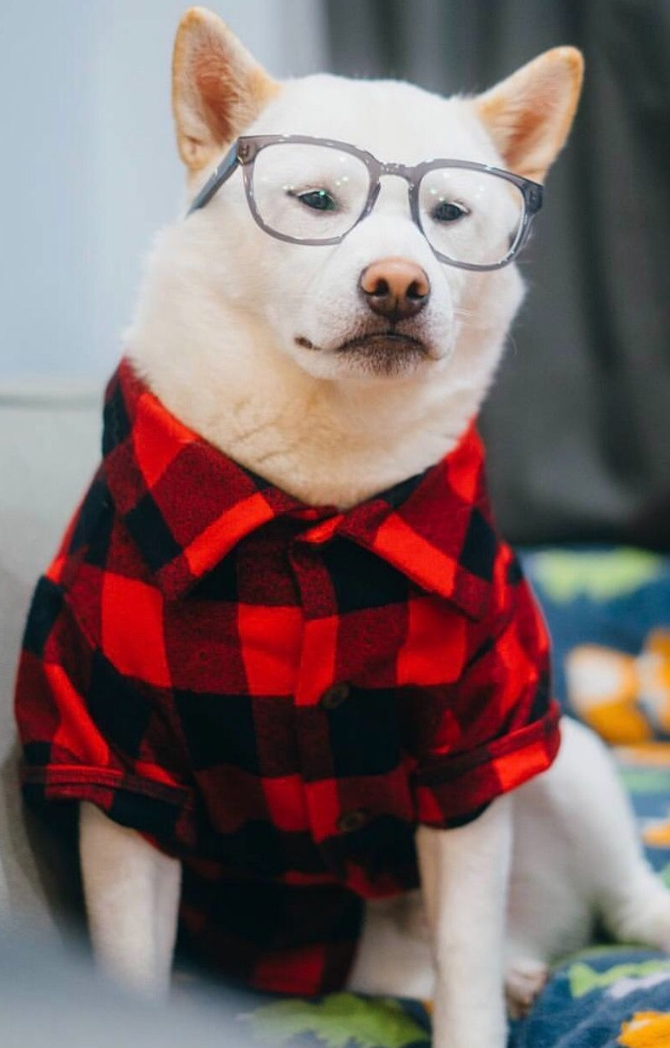
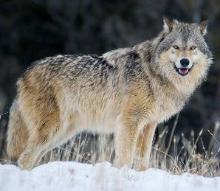
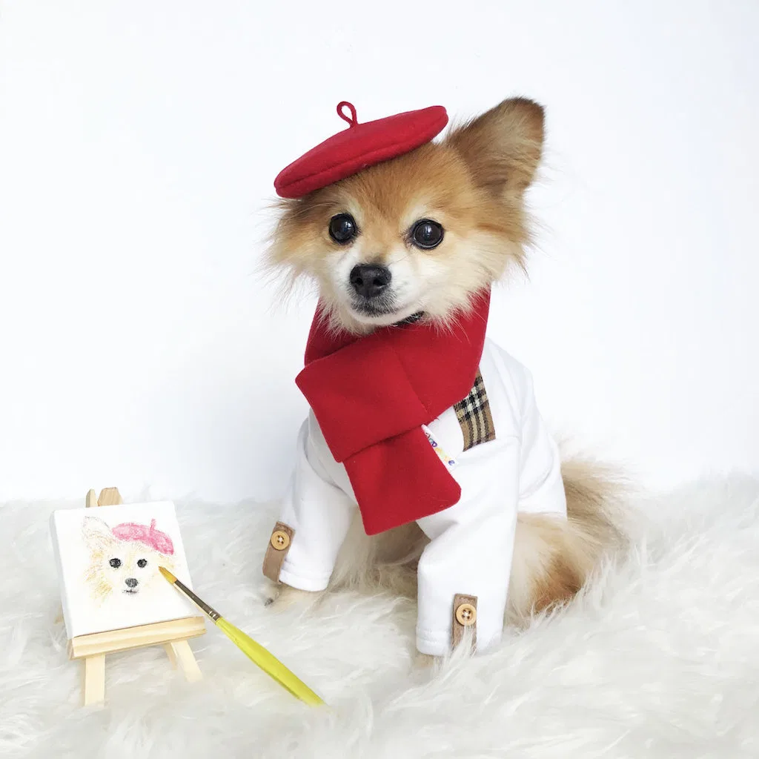
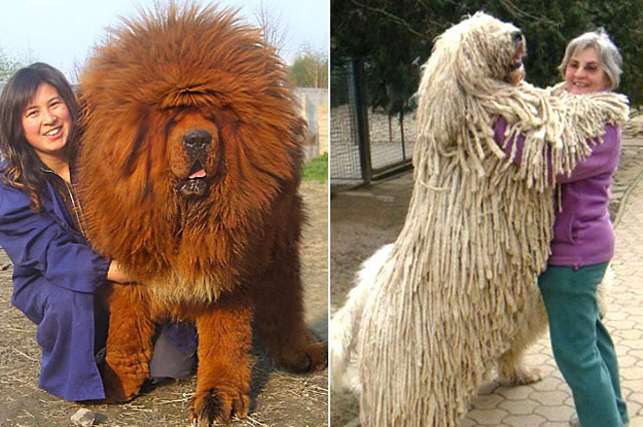
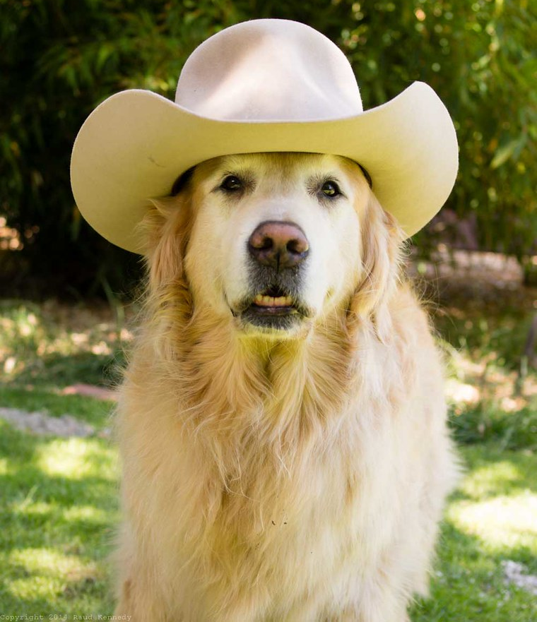
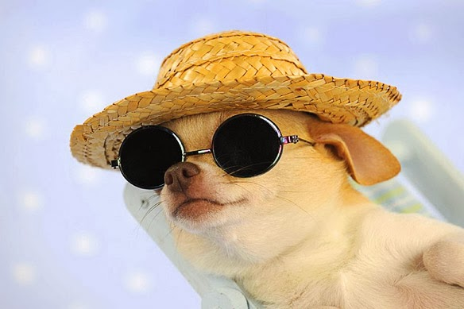
Dogs vary in size, shape, color, and behavior

Slide 12
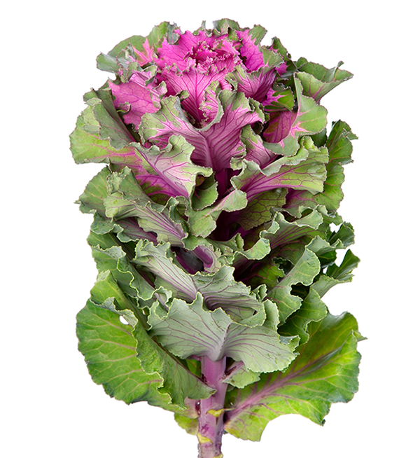
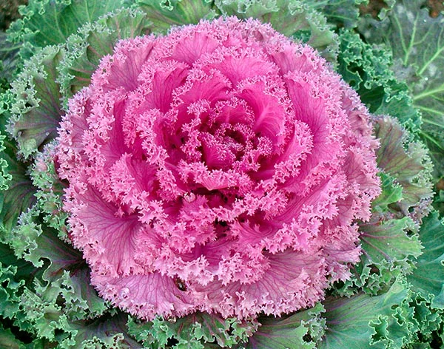
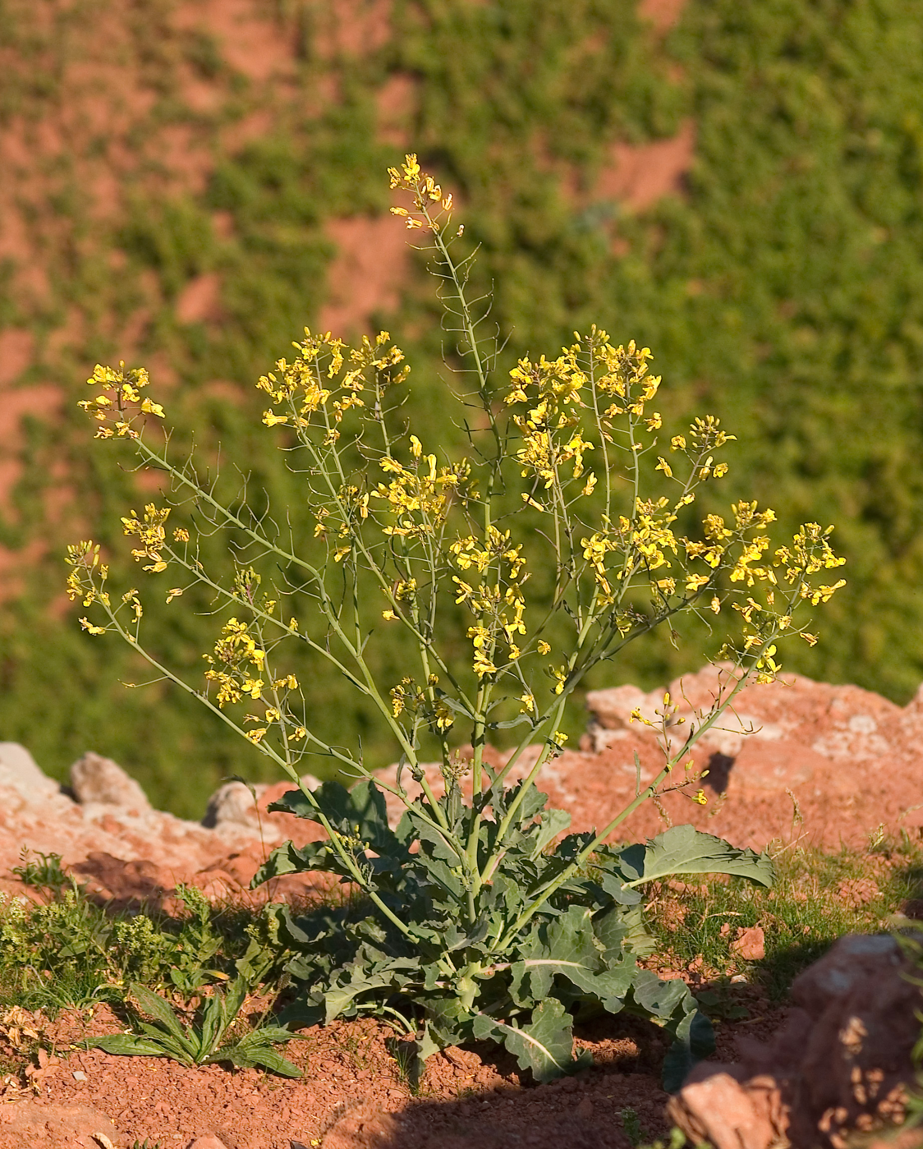
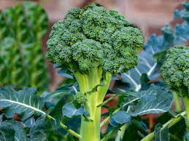
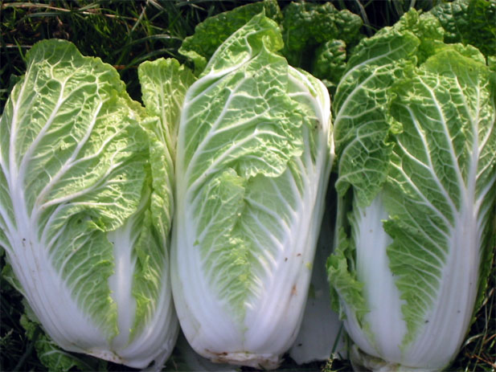
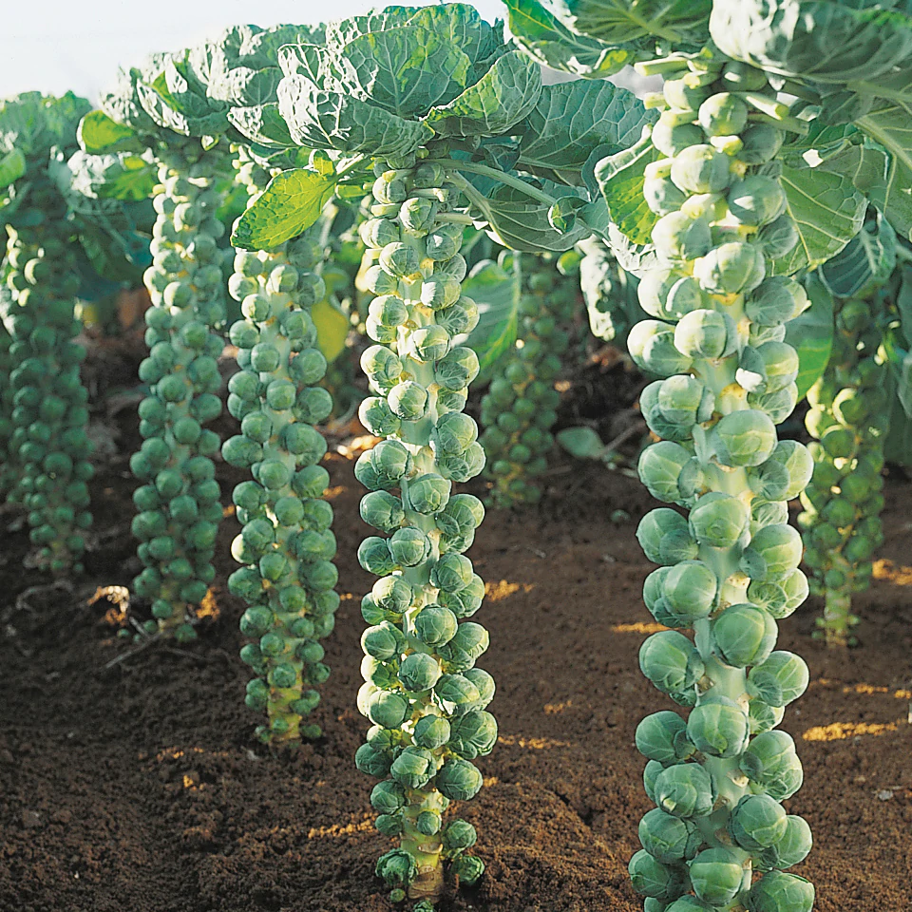
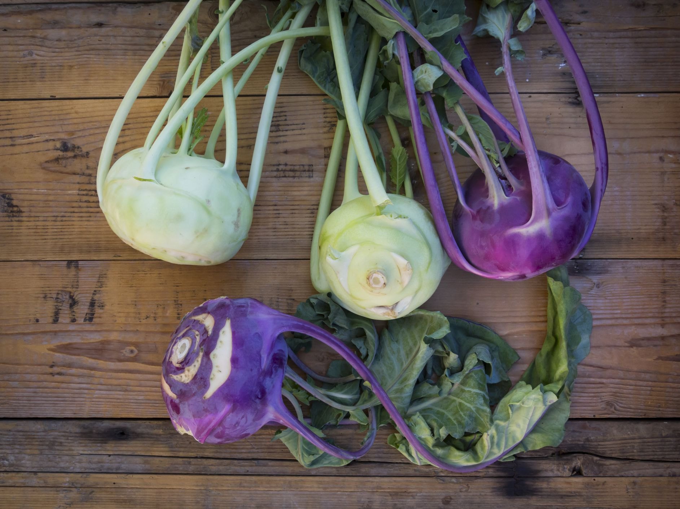
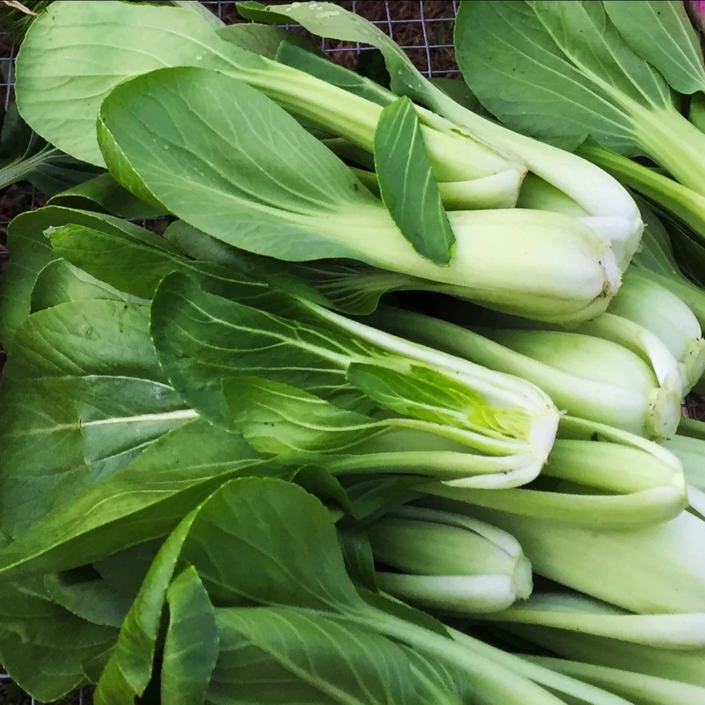
Cabbages vary in size, shape, color, and behavior too!

Slide 13
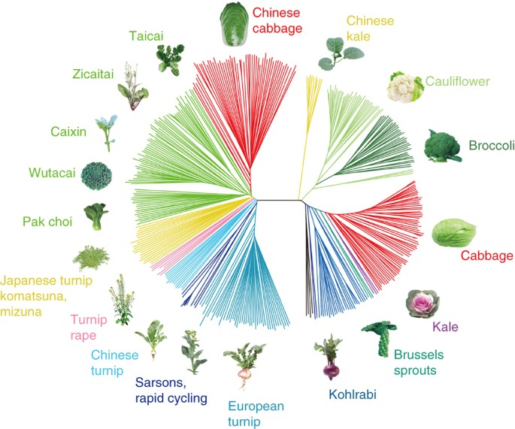
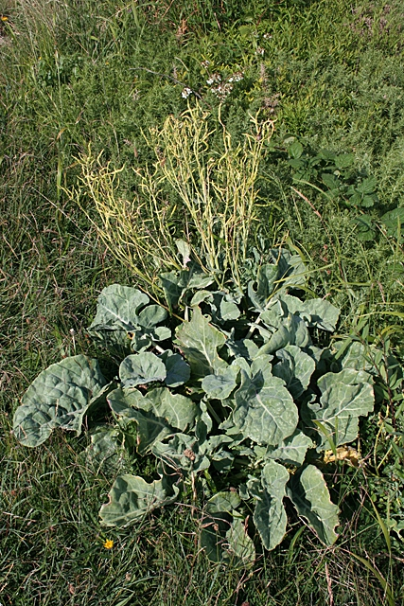
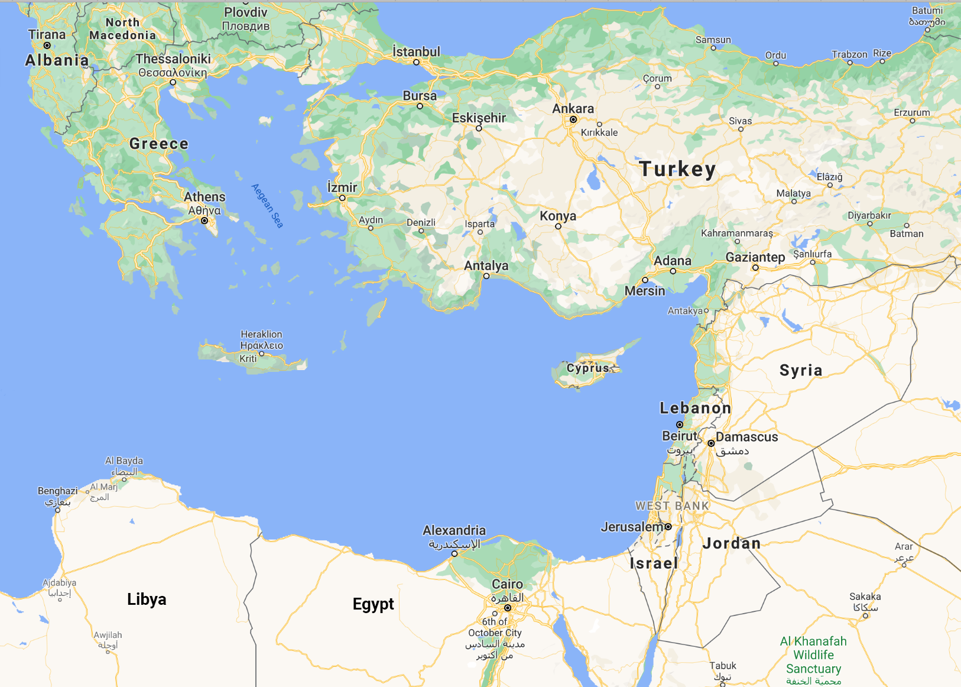
Cabbage domestication
Brassica oleracea and Brassica rapa
Native to Eastern Mediterrian
Domesticated 3,000 years ago

Slide 14
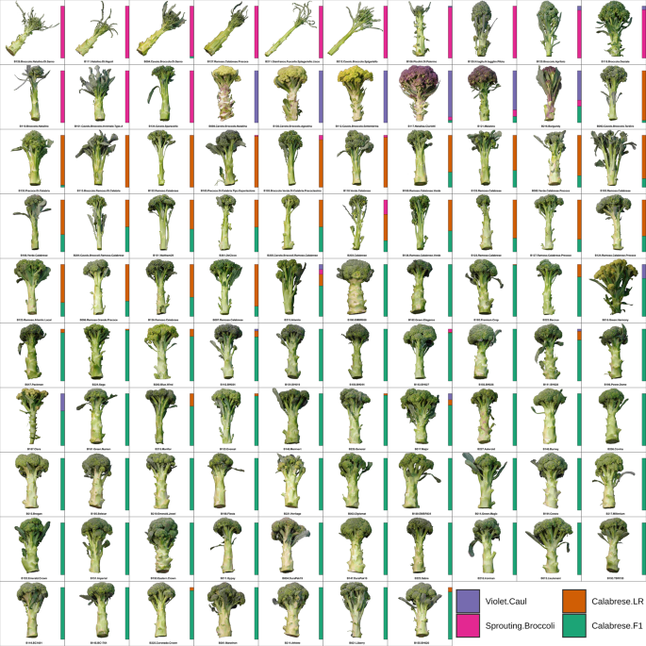
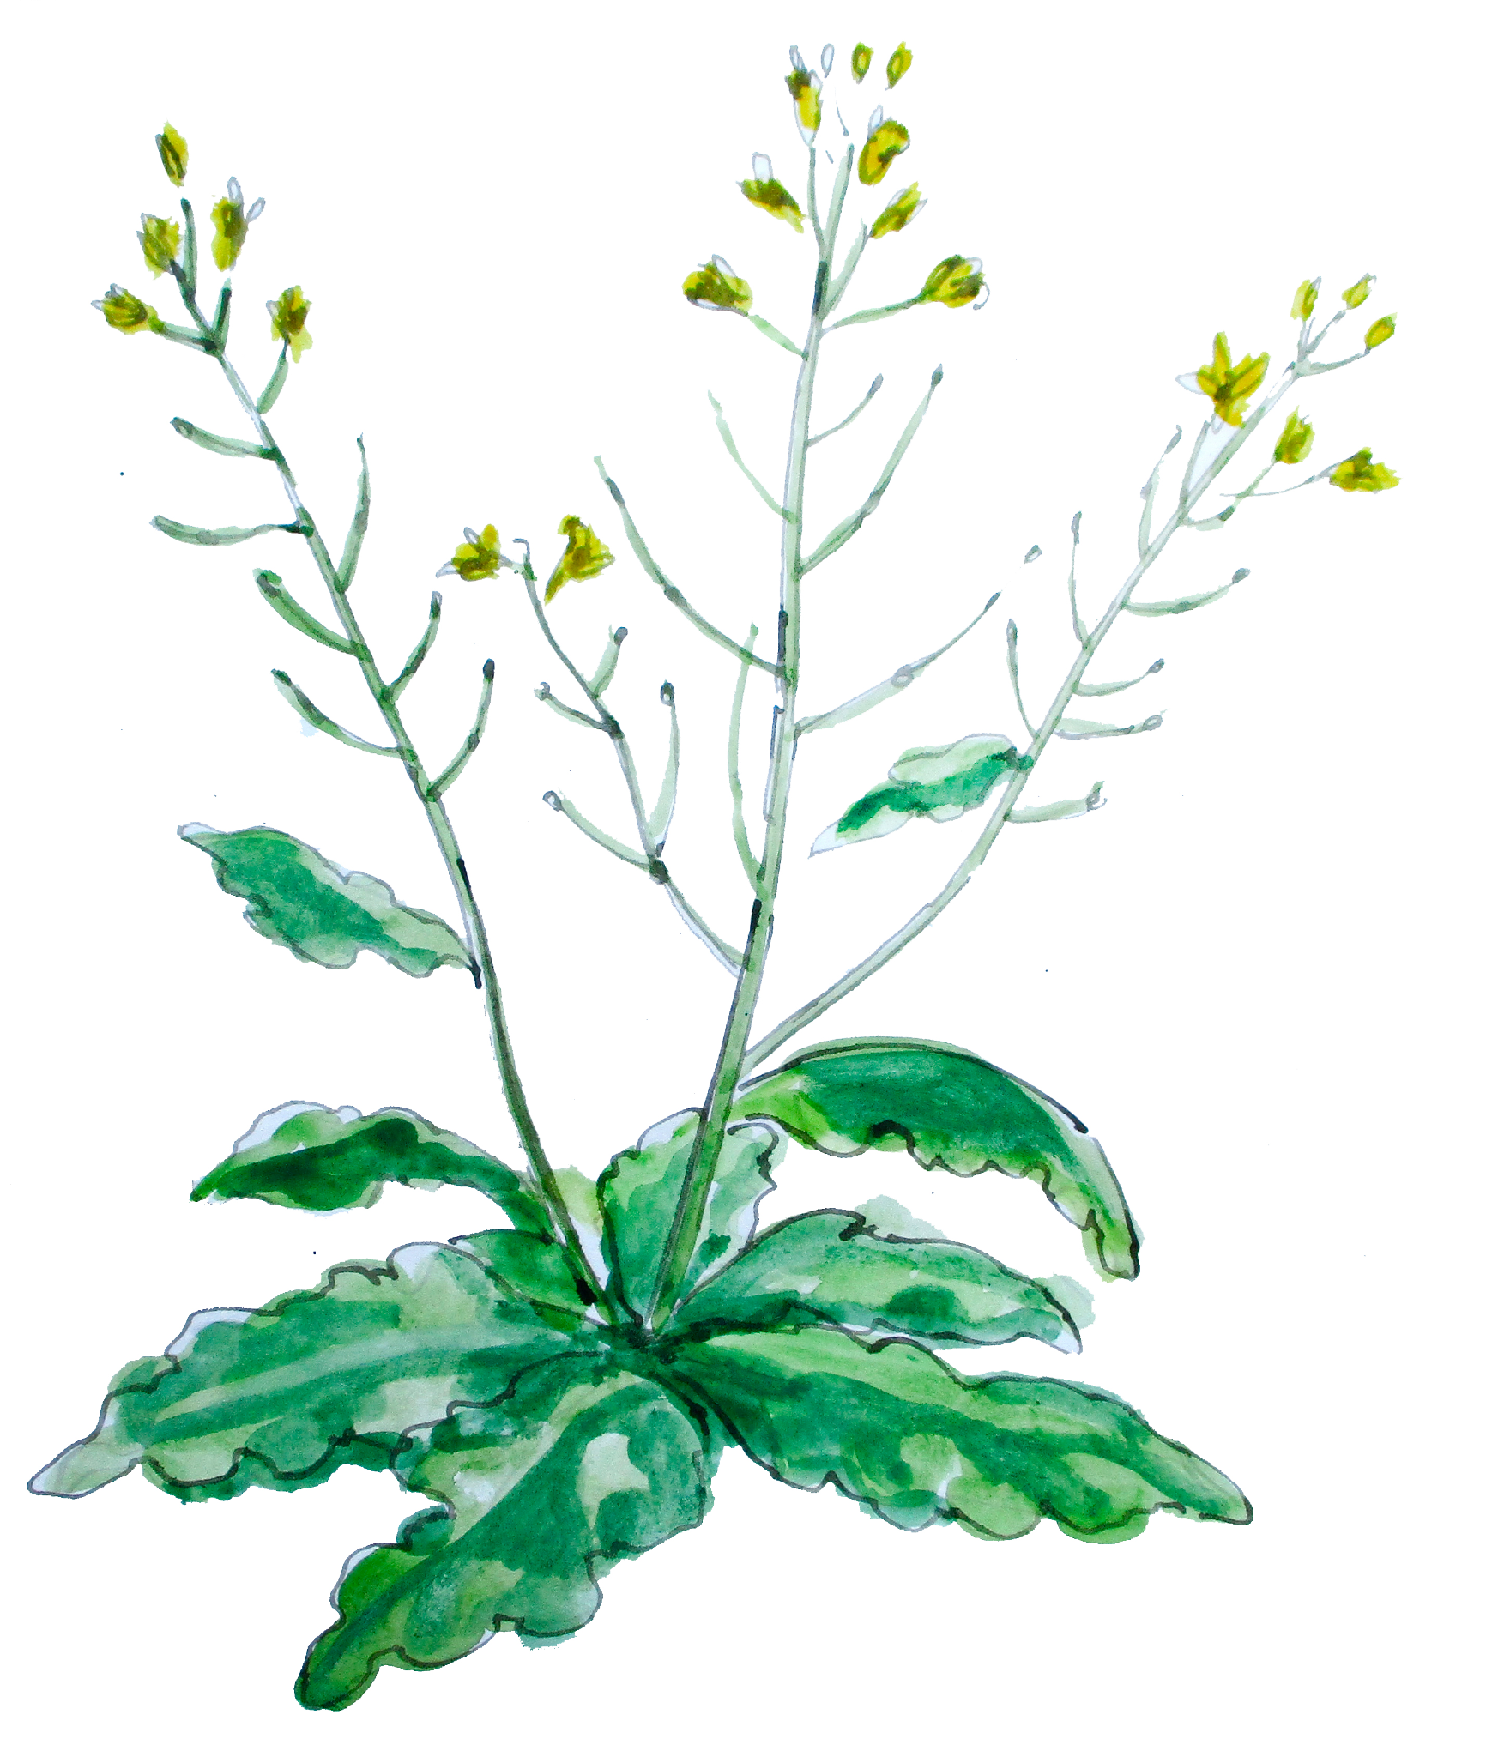
Huge variation in just broccoli shapes

Slide 15
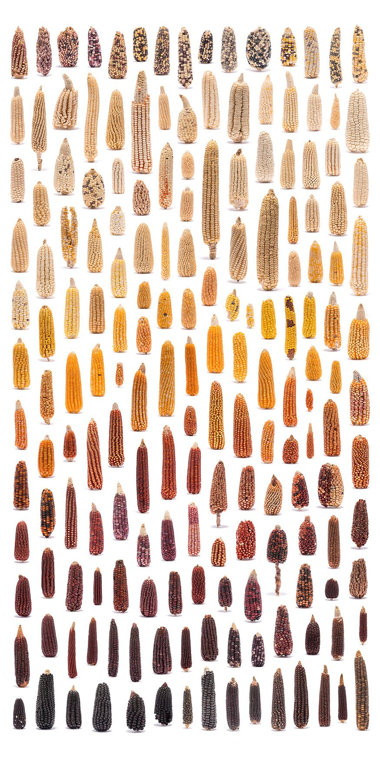
Why is this variation important?
Variation in the morphology/shapes of a species is the “stuff” evolution and natural selection works on.
This diversity can be used by plant breeders to:
Adapt plants to new environments and climates
Create new species of plants with desired characteristics
Create higher yielding varieties
And others (put your ideas in the chat)
Maize ears from CIMMYT (Mexico)

Slide 16
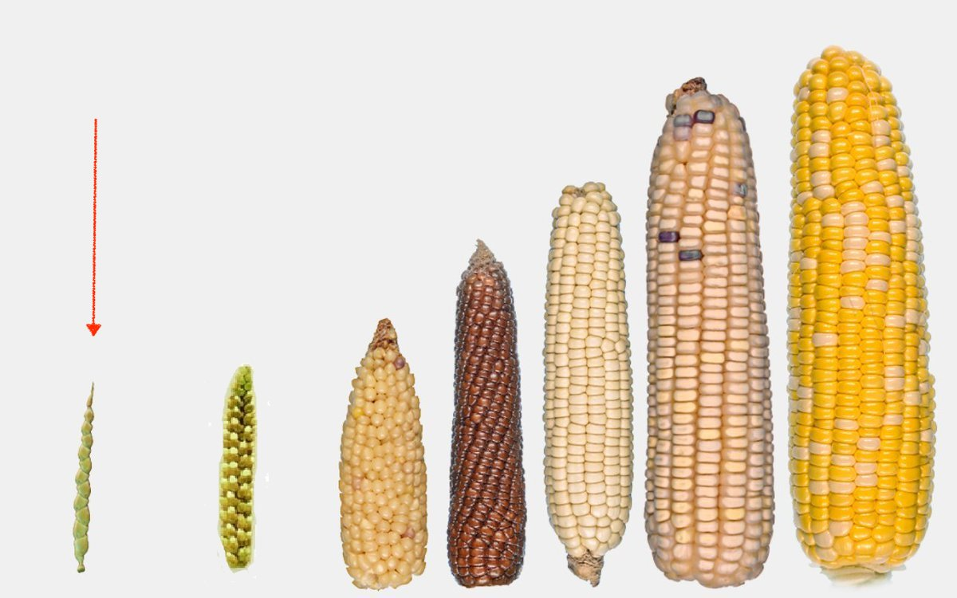
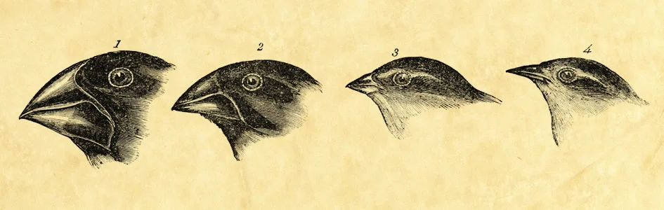
Natural versus artificial selection
Artificial Selection
Process through which populations of living organisms adapt and change to create traits/behaviors desired by humans.
Natural Selection
Process through which populations of living organisms adapt and change by themselves.
Desired plant traits: food, feed, fiber, fuel

Slide 17
Let’s start the activity!

Slide 18
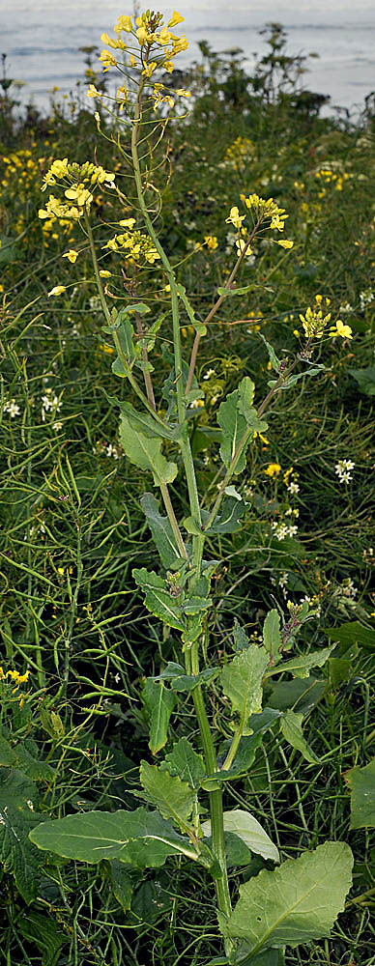
Let’s become cabbage detectives
Goal: Determine what part of of wild Brassica/cabbage modern cabbage was selected from.
Hypothesis: Different cabbages and their cousins were all selected from different parts of the same wild cabbage plant.
Methods: Dissect & investigate different Brassicas, create a super Brassica/cabbage with our newfound knowledge.

Slide 19
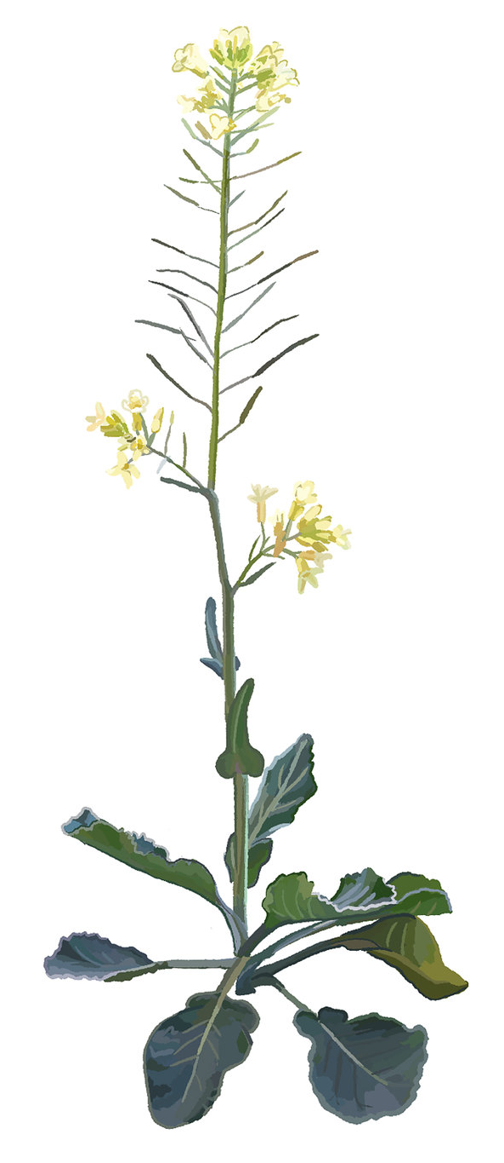
Components of wild cabbage
Flowers (terminal buds)
Seeds
Flowers - terminal buds
Seeds
Flowers - lateral buds
Stem
Leaves
Roots
Flowers (lateral buds)
Stem
Leaves
Roots

Slide 20
Materials needed
Assortment of 5-7 cabbages (~$10-20)
Brussel sprouts, bok choy, cabbage, broccoli, turnips, kohlrabi, broccolini, cauliflower, turnips, mustard/canola-oil
Cutting board & knife
Printouts of ‘super cabbage’ template
Printed cutouts of modern cabbages
Glue sticks
Cabbage investigation worksheet
Scissors

Slide 21
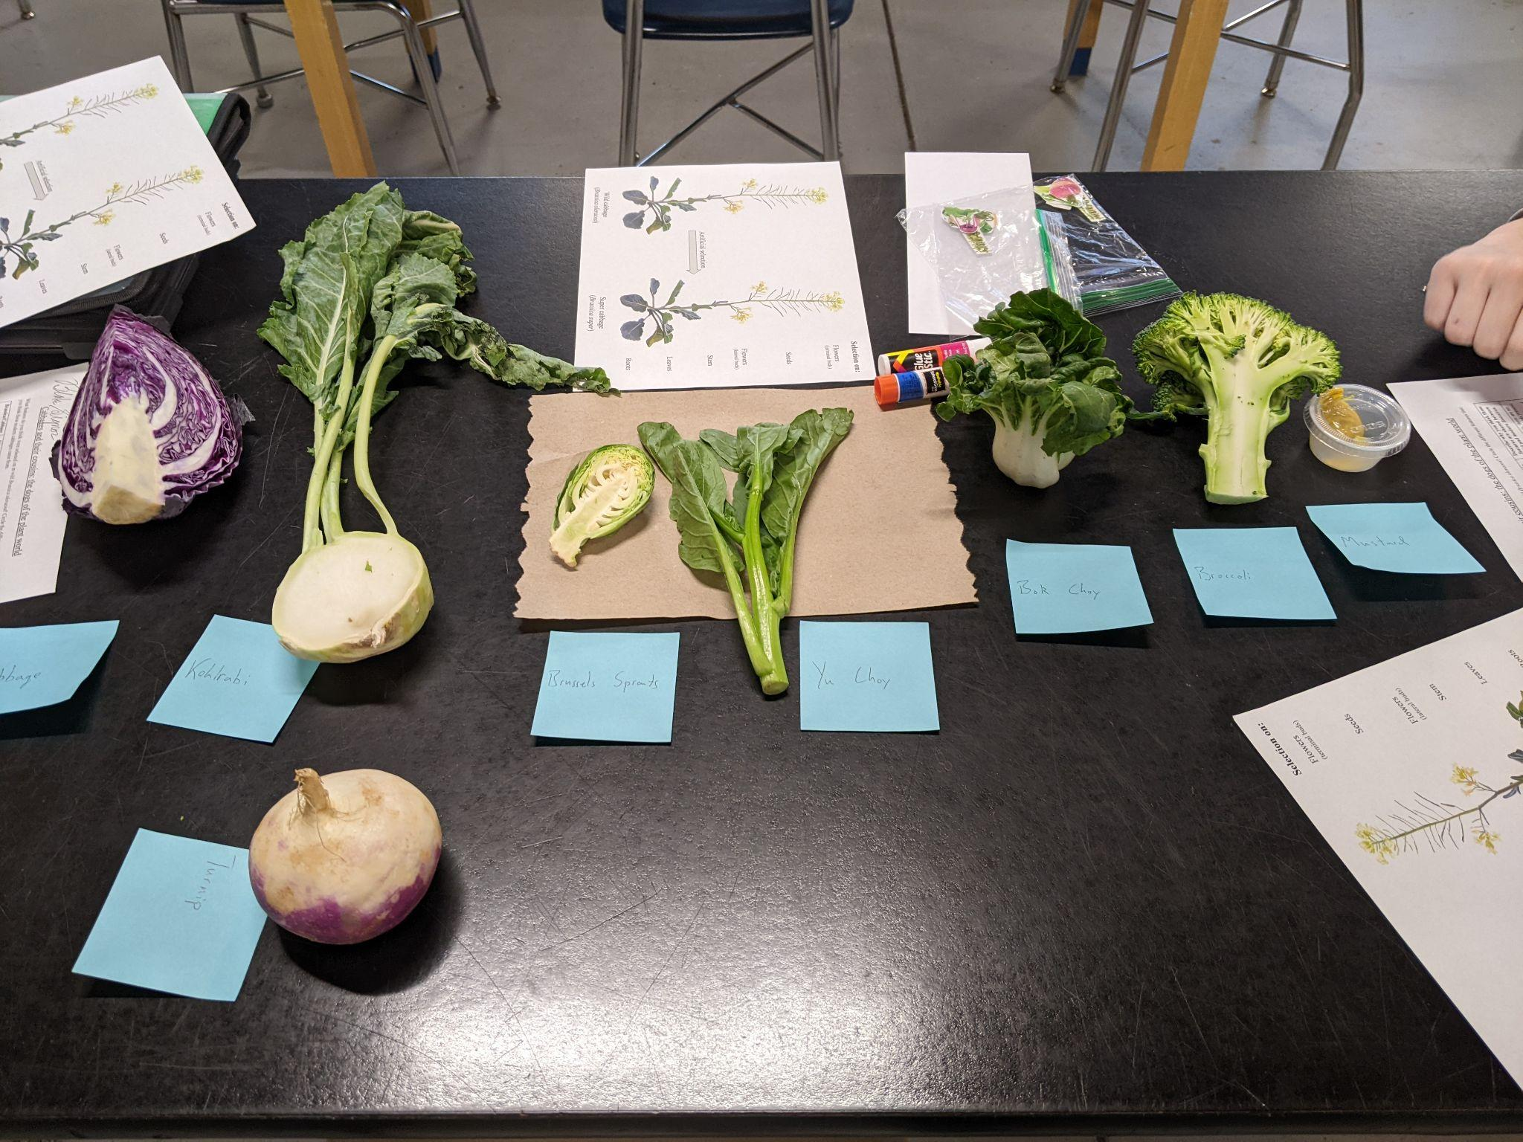
Setup
Lay out cut cabbages
Add labels
Pass out cutouts
Pass out template
Work in groups of 3-4

Slide 22
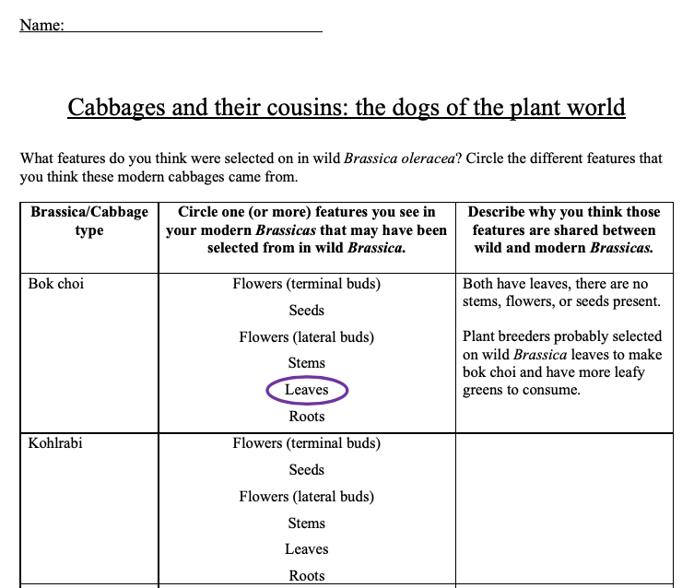
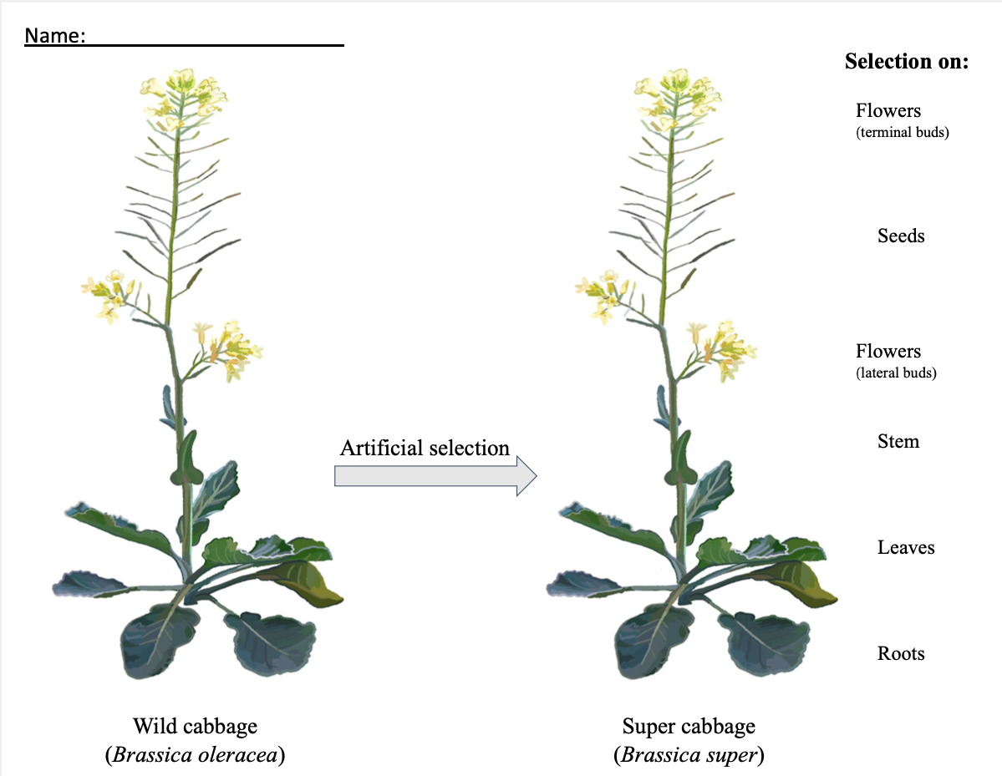
Have students fill out the worksheet as they go
Worksheet
Helper sheet/template

Slide 23
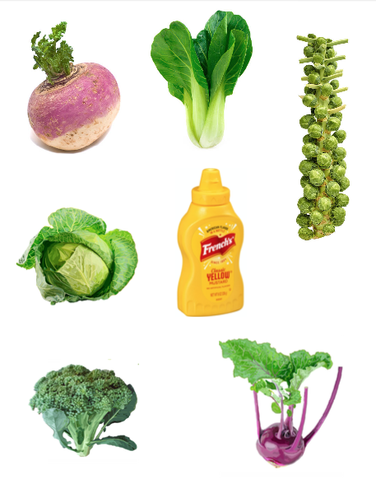
Cabbage cutouts
Have students cut these out themselves

Slide 24
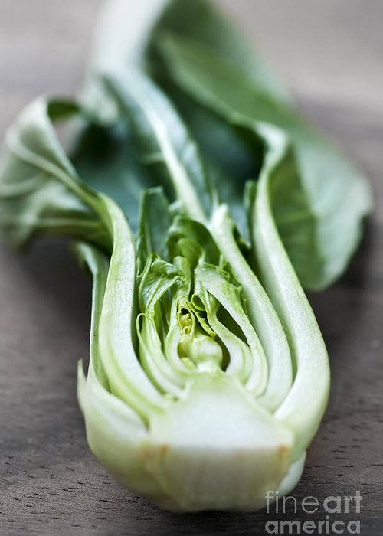
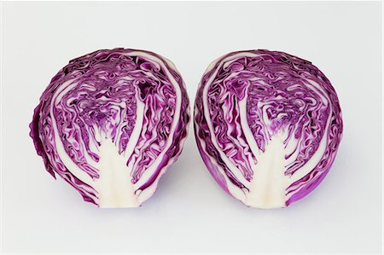
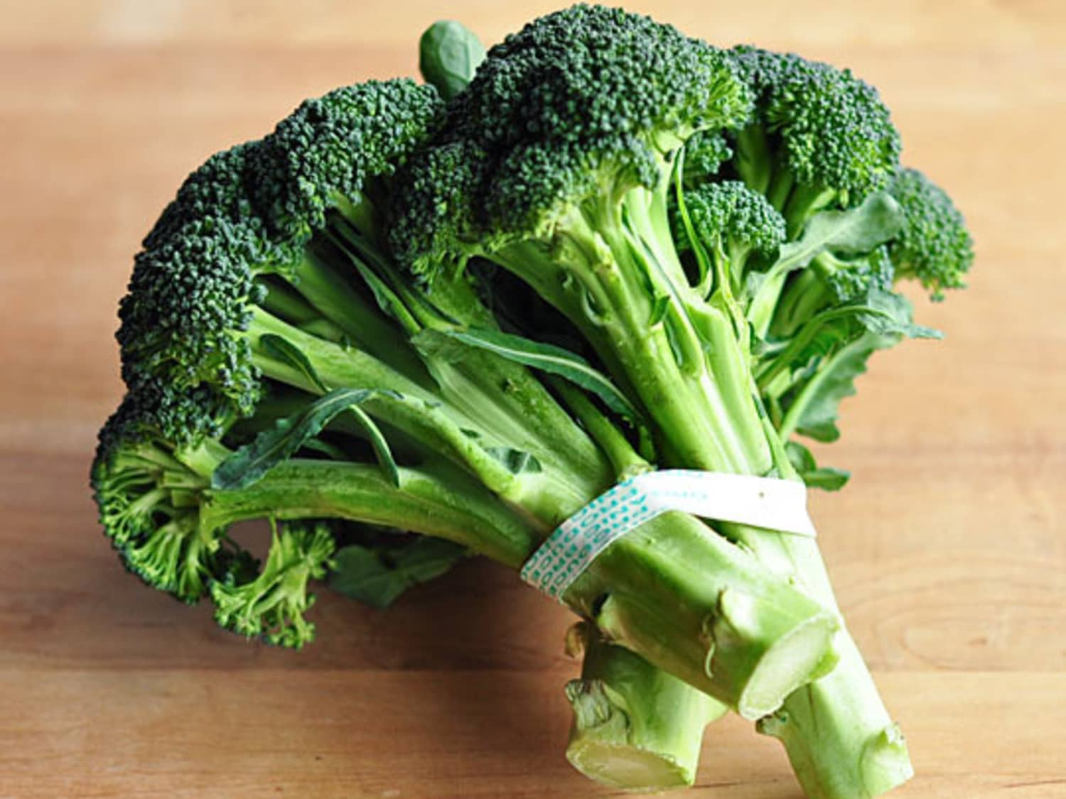
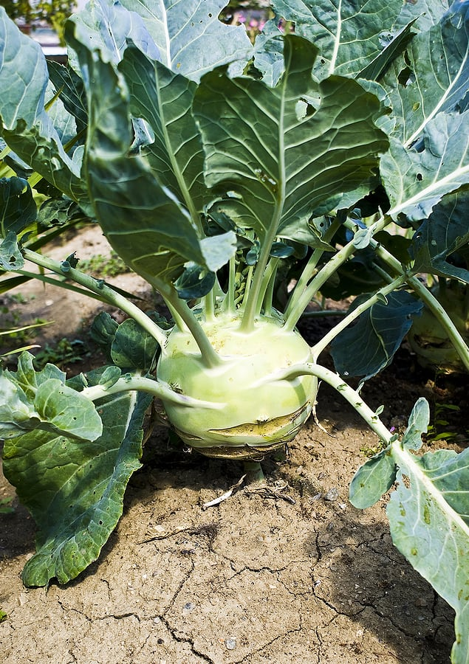
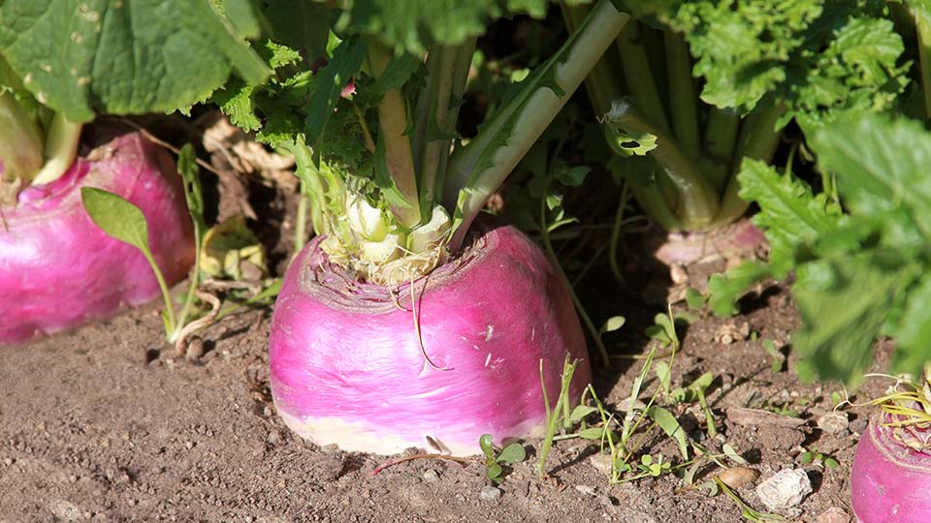
Start investigating!
Flowers (terminal buds)
Seeds
Flowers (lateral buds)
Stem
Bok choi
Cabbage
Broccoli
Leaves
Roots
Brussel sprouts
Kohlrabi
Rutabaga

Slide 25
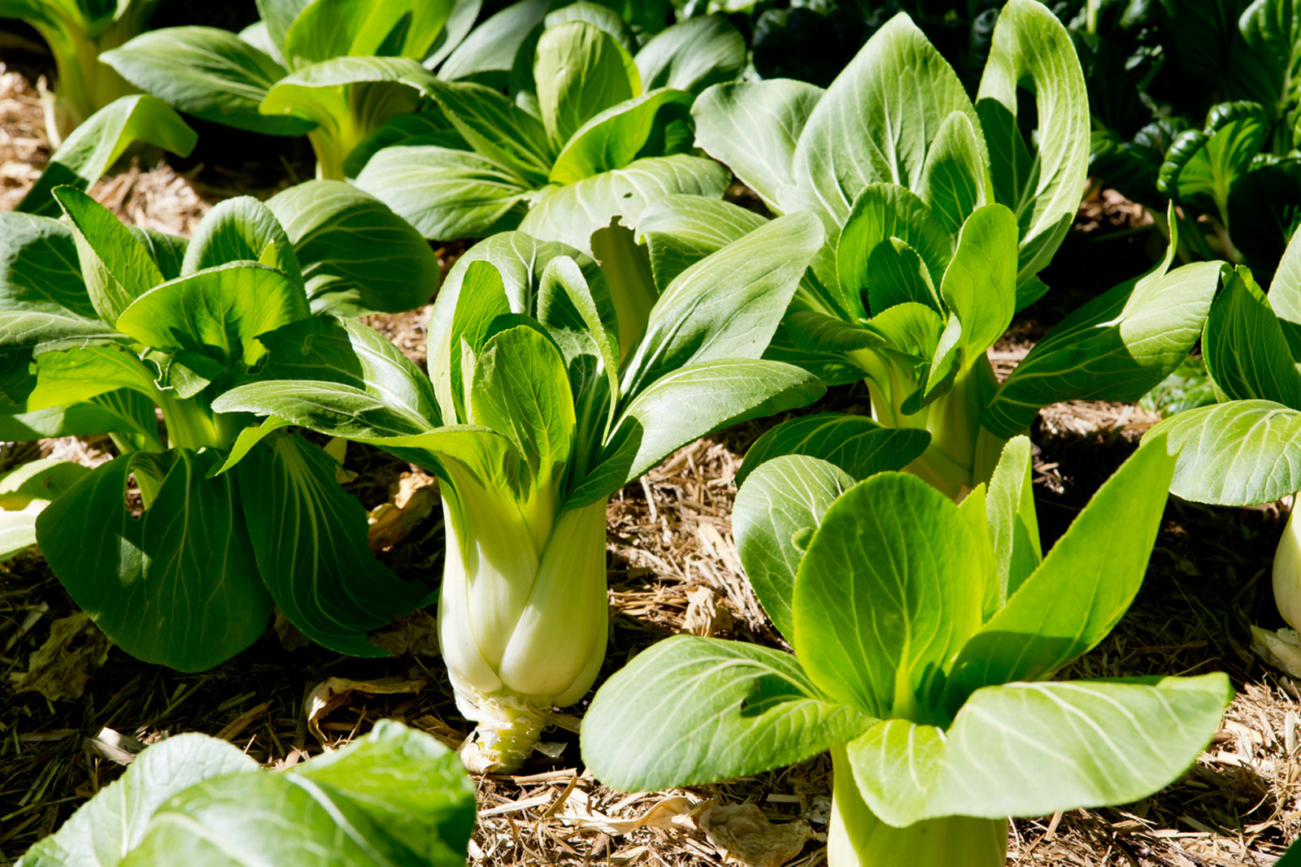
Bok choi
Flowers (terminal buds)
What structures do/don’t we see?
What similar structures are in wild cabbage?
Seeds
Flowers (lateral buds)
Stem
Leaves
Roots

Slide 26
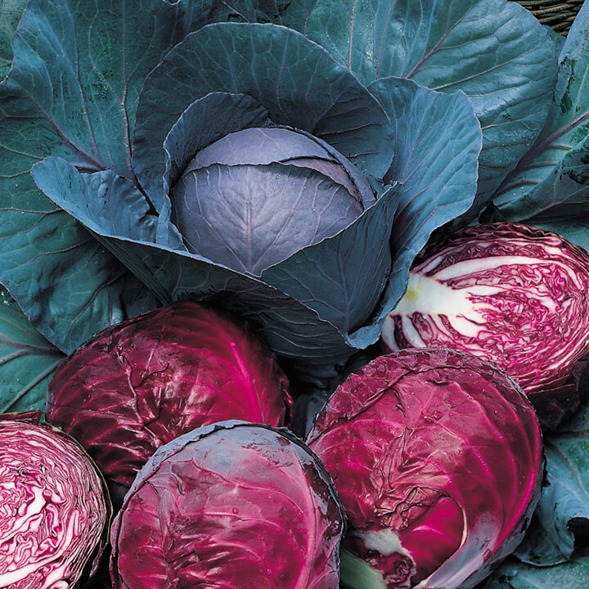
Cabbage
Flowers (terminal buds)
What structures do/don’t we see?
What similar structures are in wild cabbage?
Seeds
Flowers (lateral buds)
Stem
Leaves
Roots

Slide 27
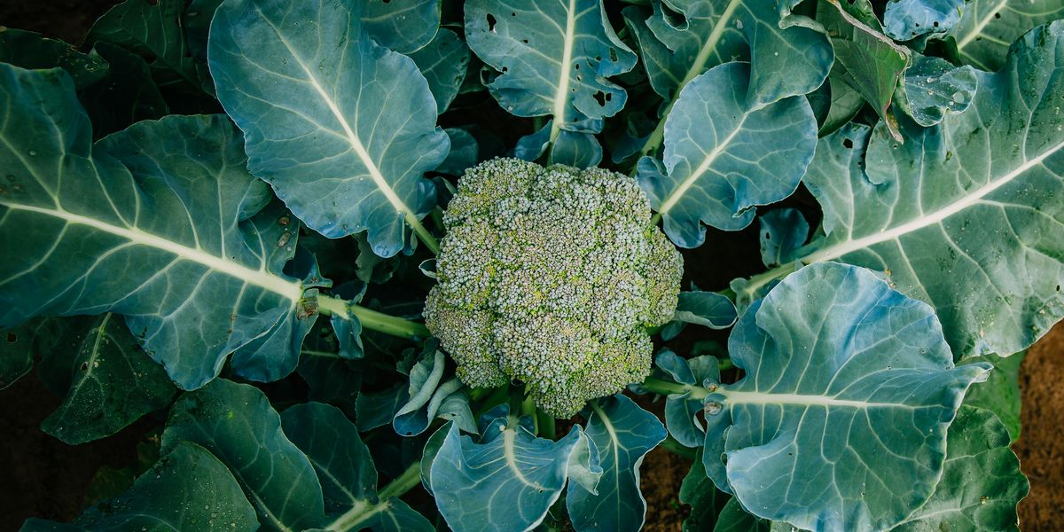
Broccoli/cauliflower
Flowers (terminal buds)
What structures do/don’t we see?
What similar structures are in wild cabbage?
Seeds
Flowers (lateral buds)
Stem
Leaves
Roots

Slide 28
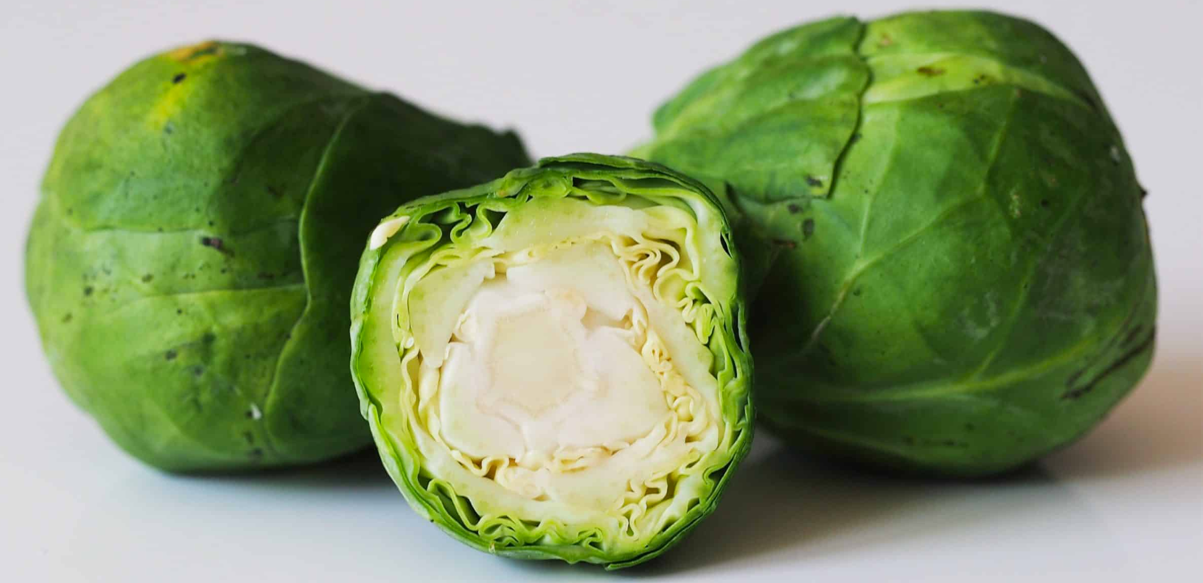
Brussel sprouts
Flowers (terminal buds)
What structures do/don’t we see?
What similar structures are in wild cabbage?
Seeds
Flowers (lateral buds)
Stem
Leaves
Roots

Slide 29
Kohlrabi
Flowers (terminal buds)
What structures do/don’t we see?
What similar structures are in wild cabbage?
Seeds
Flowers (lateral buds)
Stem
Leaves
Roots

Slide 30
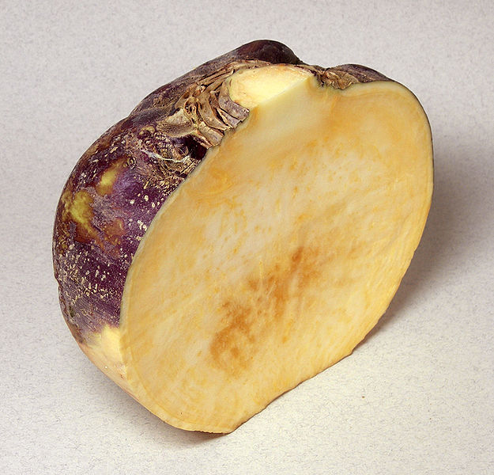
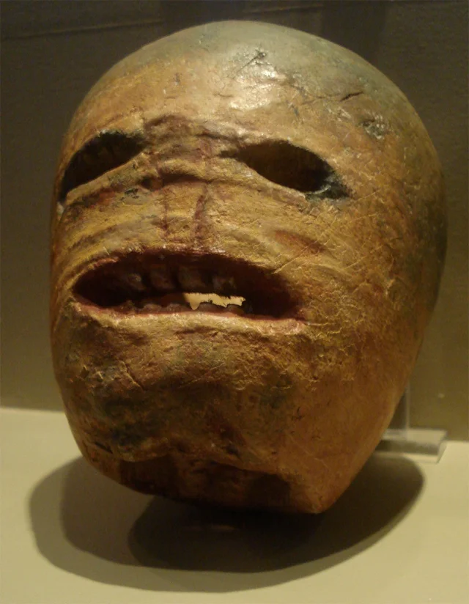
Rutabaga
Flowers (terminal buds)
What structures do/don’t we see?
What similar structures are in wild cabbage?
Seeds
Flowers (lateral buds)
Stem
Leaves
Fun fact: the earliest jack-o-lanterns were made out of rutabagas!
Roots

Slide 31
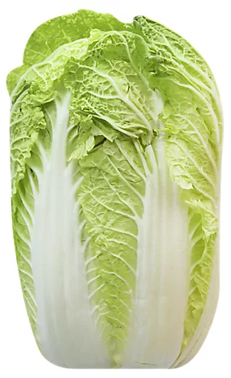

Napa cabbage
Flowers (terminal buds)
What structures do/don’t we see?
What similar structures are in wild cabbage?
Seeds
Flowers (lateral buds)
Stem
Leaves
Roots

Slide 32




Mustard
Flowers (terminal buds)
Seeds
Flowers (lateral buds)
Stem
Leaves
Roots

Slide 33

Artificial selection for edible components

Slide 34

Super cabbage assemble!
Selection on:
Glue mini cabbages onto wild cabbage
Flowers (terminal buds)
Artificial selection
Flowers (lateral buds)
Stem
Leaves
Roots
Wild cabbage
(Brassica oleracea)
Super cabbage
(Brassica super)

Slide 35




Super cabbage assemble!
Selection on:
Flowers (terminal buds)
Artificial selection
Flowers (lateral buds)
Stem
Leaves
Roots
Wild cabbage
(Brassica oleracea)
Super cabbage
(Brassica super)

Slide 36

Thanks!
Any questions?

